Slide 1

r
Department of Computer Applications
Robust Data-Driven Analysis for Electricity Theft
Attack-Resilient Power Grid
Presentation By:
Govardhan Reddicharla
Roll No: 23691f0049
Under The Guidance of:
Dr.Srinivasan J
Assistant Professor
Department of Computer Applications

Slide 2
CONTENTS
Title
Abstract
Introduction
Literature Review
Existing System
Proposed System
Hardware and Software Requirements
Feasibility Study
Module Descriptions
System Implementation
Results/Performance Evaluation
Conclusion
Scope for Future Enhancement
Screenshots & Sample Code
References

Slide 3
ABSTRACT
Problem statement:
Electricity theft in smart grids poses a major challenge due to data imbalance, anomalies, and evolving fraud techniques. Existing systems often fail to detect such thefts accurately, leading to operational and financial losses.
Project objectives:
To develop a robust machine learning framework that accurately detects electricity theft from smart meter data. The goal is to enhance detection accuracy, reduce false positives, and support real-time insights via a dashboard.
Brief solution approach:
The system applies preprocessing, feature selection, and SMOTE to handle imbalanced data, followed by model training using Decision Tree, Random Forest, SVM, XGBoost, ANN. A Flask-based dashboard visualizes predictions for real-time monitoring.

Slide 4
INTRODUCTION
Electricity theft is a major challenge in modern power distribution system, leading to substantial financial losses and instability in the energy grid.
The system enhances grid resilience against theft attacks by analyzing consumption behaviour.This project proposes a machine learning-based solution to identify and prevent electricity theft in smart power grids.
It integrates advanced data analytics, preprocessing techniques, feature engineering, and modern classification models like Random Forest, DT, XGBoost, SVM, and ANN.
We balance the dataset using SMOTE to improve model generalization. The best-performing model is deployed in a lightweight dashboard using Flask for real-time use.
The overal goal is to build a stable , intelligent, and attack resilient energy grid that supports the future of sustainable development.

Slide 5
LITERATURE REVIEW
S. No | Title | Authors | Journal/ Year | Methods | Merits | Limitations
1 | CatBoost-based supervised machine learning framework for electricity theft detection | S. Hussain et al. | Energy Reports, 2021 | CatBoost, Feature Engineering, Outlier Detection | Fast training, Strong handling of categorical features | Requires high-quality feature selection
2 | An adaptive synthesis to handle imbalanced Big Data with deep Siamese network for electricity theft detection in smart grids | N. Javaid, N. Jan, M. Javed | Journal of Parallel and Distributed Computing, 2021 | Deep Siamese Networks, Data Balancing Techniques | Improved handling of imbalanced data | Requires expert knowledge for parameter tuning
3 | Hybrid deep neural networks for detection of non-technical losses in electricity smart meters | M.-M. Buzau, J. Tejedor-Aguilera, P. Cruz-Romero, A. Gómez-Expósito | IEEE Transactions on Power Systems, Mar. 2020 | Hybrid Deep Neural Networks (DNN), Convolutional Neural Networks (CNN), Autoencoders | Robust feature extraction, High accuracy in complex data patterns | Requires large computational resources, Risk of overfitting
4 | Robust Big Data analytics for electricity price forecasting in the smart grid | K. Wang, C. Xu, Y. Zhang, S. Guo, A. Y. Zomaya | IEEE Transactions on Big Data, Mar. 2019 | Big Data Analytics, Machine Learning Models, Time Series Analysis | Efficient handling of large data volumes, Improved prediction accuracy | High implementation cost, Requires extensive data labeling
5 | Detection of non-technical losses using smart meter data and supervised learning | M. M. Buzau, J. Tejedor-Aguilera, P. Cruz-Romero, | IEEE Transactions on Smart Grid, May 2019 | Supervised Learning, Feature Engineering, Data Clustering | High detection precision, Efficient for small-scale grids | Performance degrades with incomplete data

Slide 6
EXISTING SYSTEM
Manual Inspection: Relies on human meter readers; time-consuming and prone to error.
Rule-Based Alerts: Uses fixed thresholds to detect anomalies—ineffective for complex theft.
Basic Machine Learning: Earlier models often ignore class imbalance and feature importance.
No Visualization: Lack of dashboards or interpretability in existing tools.
Limitations:
Limited Accuracy: High false negatives due to basic or unoptimized models.
Labor Intensive: Manual audits delay detection and increase costs.
Outdated Techniques: Cannot adapt to evolving theft strategies.
No Real-Time Capabilities: Detection and response are delayed, increasing losses

Slide 7
PROPOSED SYSTEM
Smart ML-Based Detection: Automates theft detection with higher accuracy.
Balanced Data Handling: Applies SMOTE to mitigate class imbalance, boosting theft recall.
Modular Pipeline: Covers preprocessing, training, evaluation, and deployment.
Interactive Dashboard: Provides real-time alerts and visual insights via Flask app.
Advantages:
Higher Accuracy: XGBoost and RF provide improved performance with balanced data.
Real-Time Monitoring: Flask dashboard enables quick decisions and alerts.
Scalability: Easily expandable for larger datasets and real-world deployment.
Cost Efficiency: Reduces human labor, loss, and operational expenses.

Slide 8





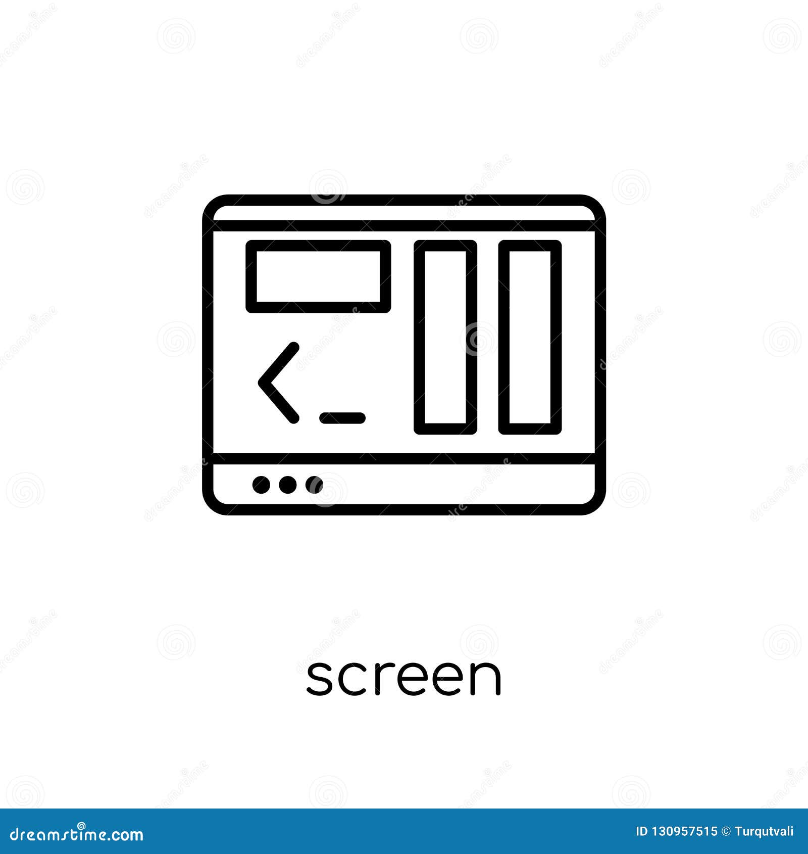


ARCHITECTURAL DESIGN OF PROPOSED SYSTEM
System
Electricity dataset
Output Screen
Data Preprocessing
Feature Extraction
Model
Implementation
(RF, DT, SVM, XGBoost, ANN)
Input
Theft
No Theft

Slide 9
HARDWARE AND SOFTWARE REQUIREMENTS
Software Requirements:
Operating System | : Windows 11 or Above
Server | : Flask (for interface/dashboard)
Programming | : Python 3.7 or Above
Front End | : HTML , CSS , Bootstrap
IDE | : VS Code
Database | : MySQL
Hardware Requirements:
System | : Intel Core i5 or Higher
Hard Disk | : 512 GB (SSD Preferred)
RAM | : 8 GB Minimum

Slide 10
FEASIBILITY STUDY
A. Technical Feasibility:
The system is technically feasible with existing AI/ML technologies, smart grid compatibility, and sufficient hardware support.
B. Economic Feasibility:
It is cost-effective by reducing theft losses and operational costs, and it scales efficiently for various grid sizes.
C. Operational Feasibility:
The system is operationally viable with automated detection and user-friendly dashboards for seamless utility monitoring.
D. Legal Feasibility:
It complies with data privacy and energy regulations, ensuring secure and lawful electricity theft detection. E. Schedule Feasibility:
The system can be developed and implemented within 6–12 months with phased deployment for better adaptability.

Slide 11
MODULES DESCRIPTION
Data Collection & Input Module:
Collects smart meter electricity consumption data from customers.
Handles raw data ingestion (CSV, database, or simulated).
Validates structure and handles missing input records.
Preprocessing Module:
Cleanses the data by removing anomalies, filling missing values.
Applies SMOTE to handle class imbalance (theft vs. normal).
Normalizes and scales data for better ML performance.
Feature Selection & Extraction Module:
Identifies important features using statistical methods and model-based rankings.
Reduces dimensionality to improve model accuracy and training speed.
Prepares the dataset for input to machine learning algorithms.

Slide 12
MODULES DESCRIPTION
Model Training & Prediction Module:
Trains various ML classifiers (Decision Tree, Random Forest, SVM, ANN, XGBoost).
Evaluates models using metrics like Accuracy, Recall, and F1-score.
Predicts whether electricity usage is normal or fraudulent.
Visualization & Dashboard Module:
Built using Flask web framework.
Displays prediction results, alerts for theft detection, and performance metrics.
Allows admin users to view usage data, track theft events, and monitor model output.

Slide 13
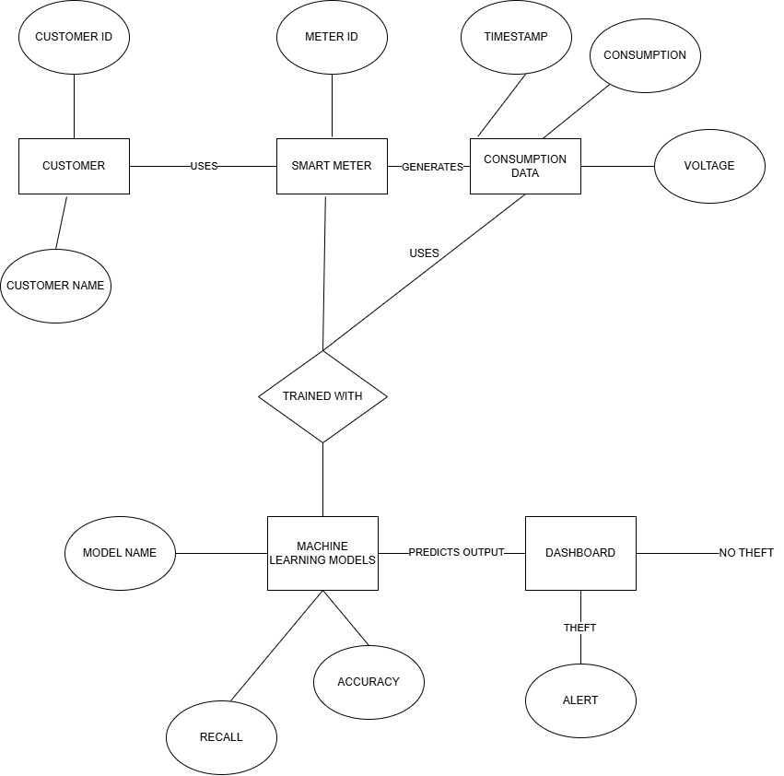
ER DIAGRAM

Slide 14
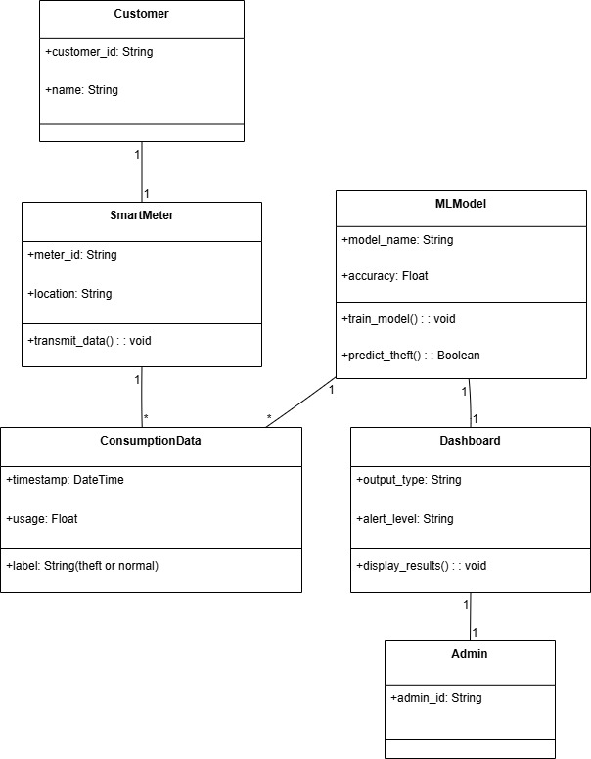
UML DIAGRAMS
Class Diagram

Slide 15
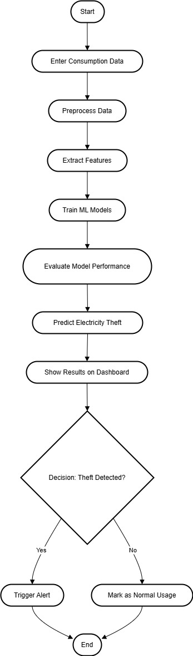
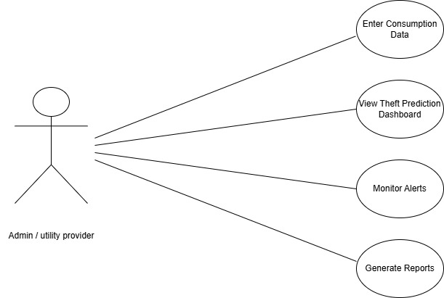
Use Case Diagram
Activity Diagram

Slide 16
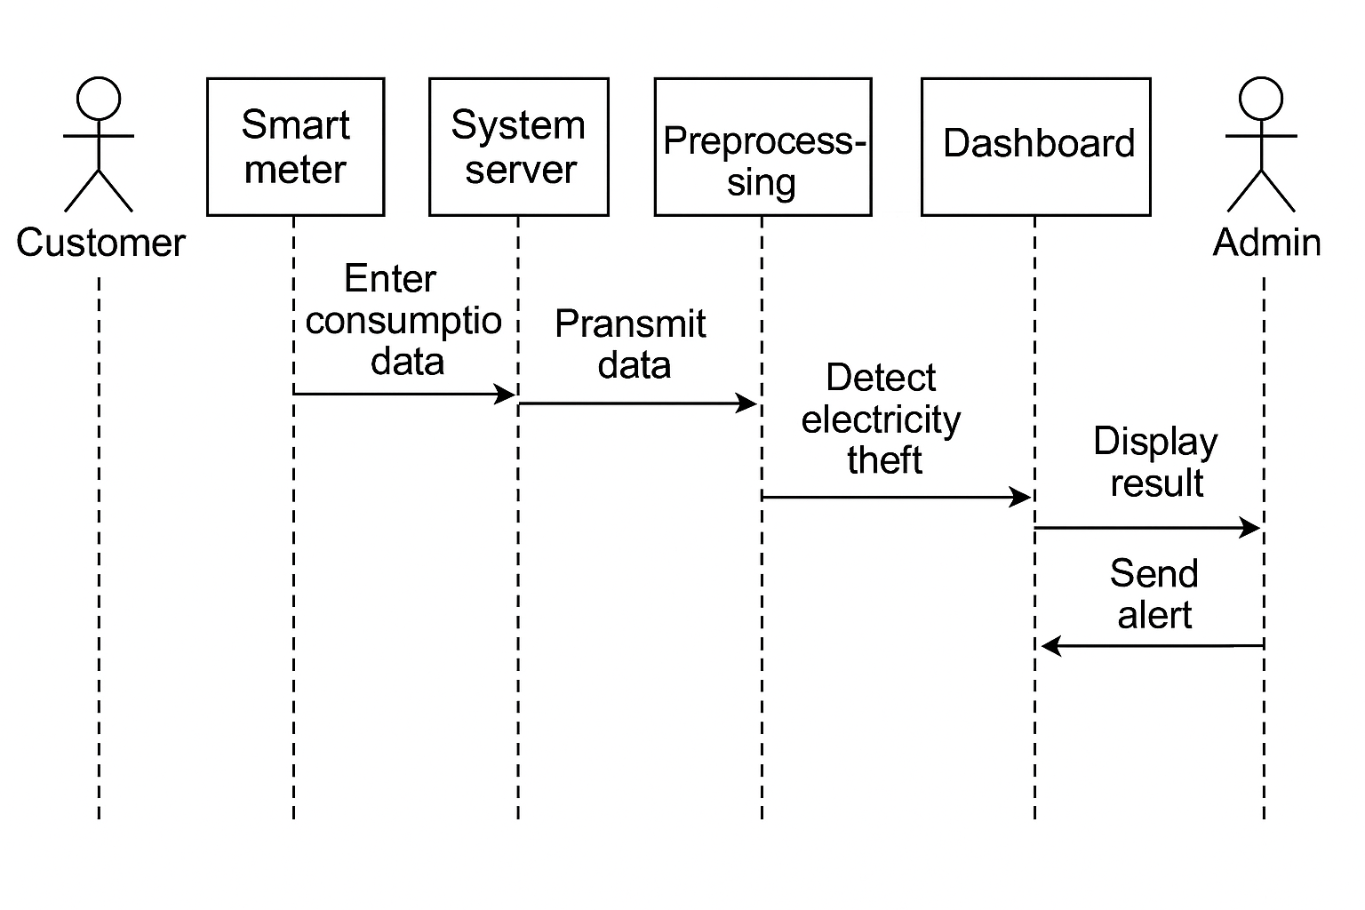
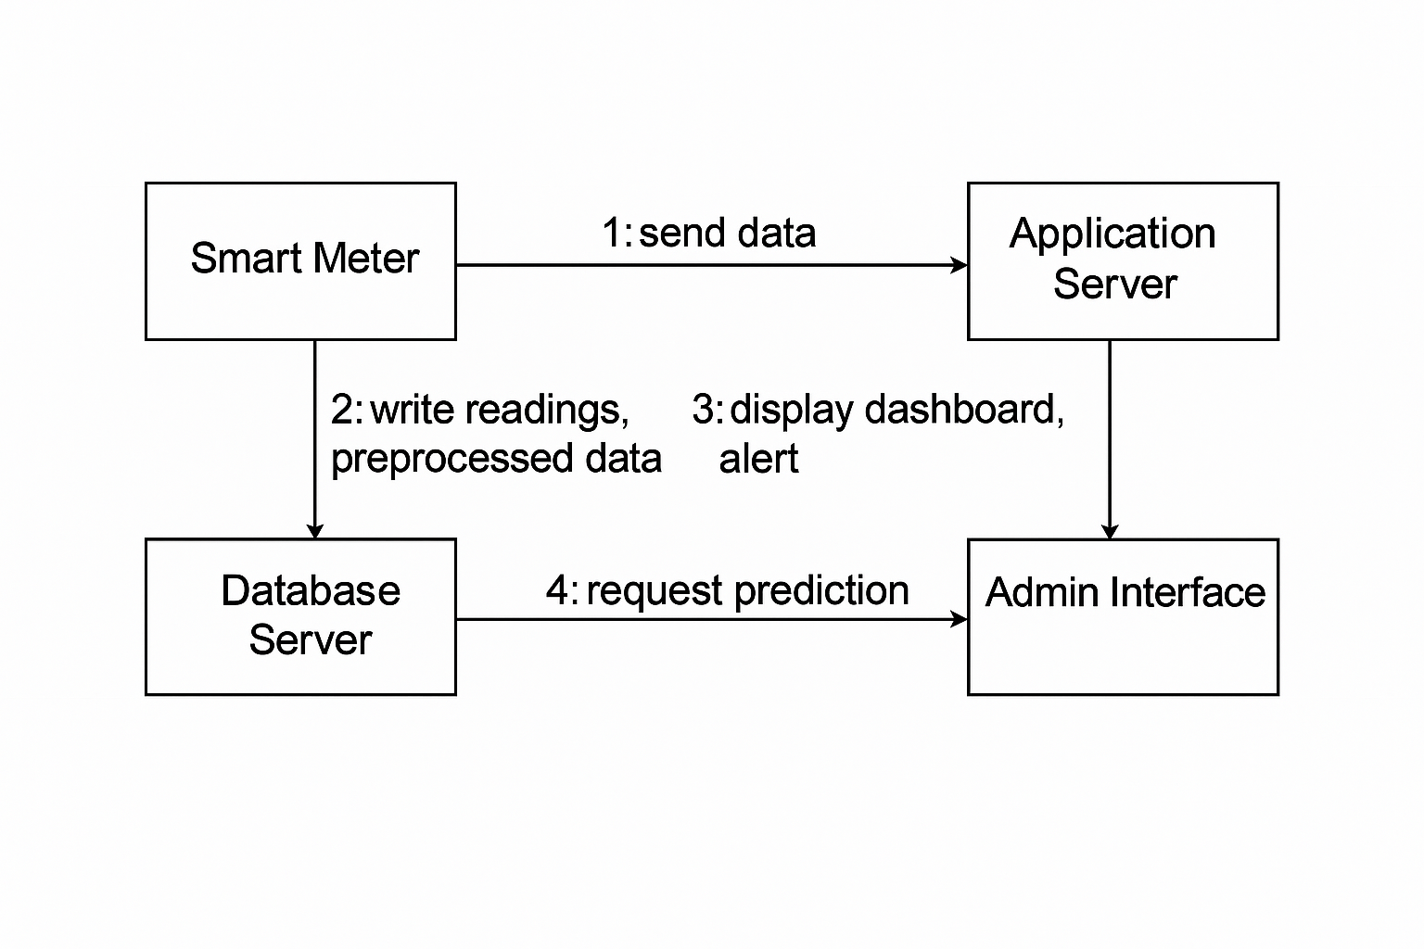
Sequence Diagram
Collaboration Diagram

Slide 17
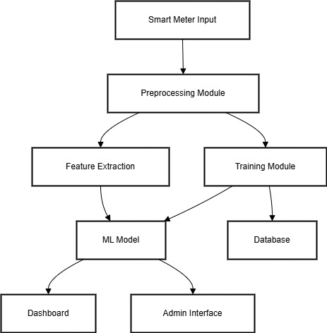
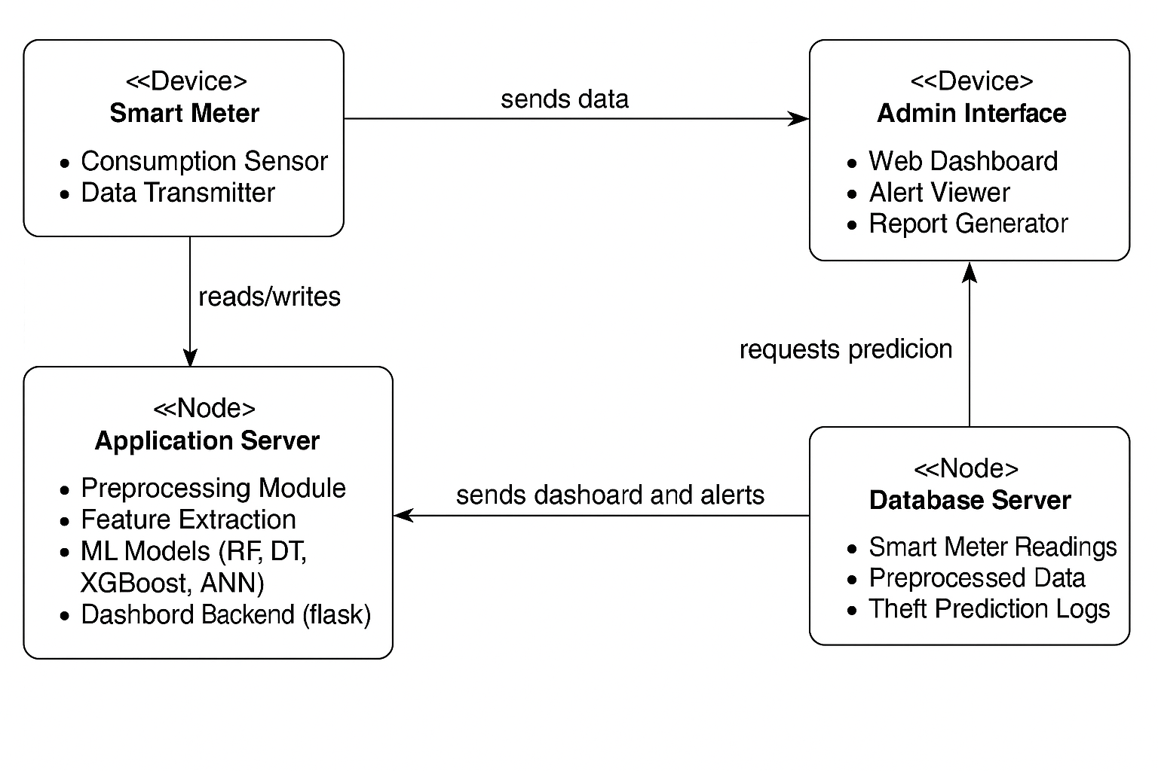
Component Diagram
Deployment Diagram

Slide 18
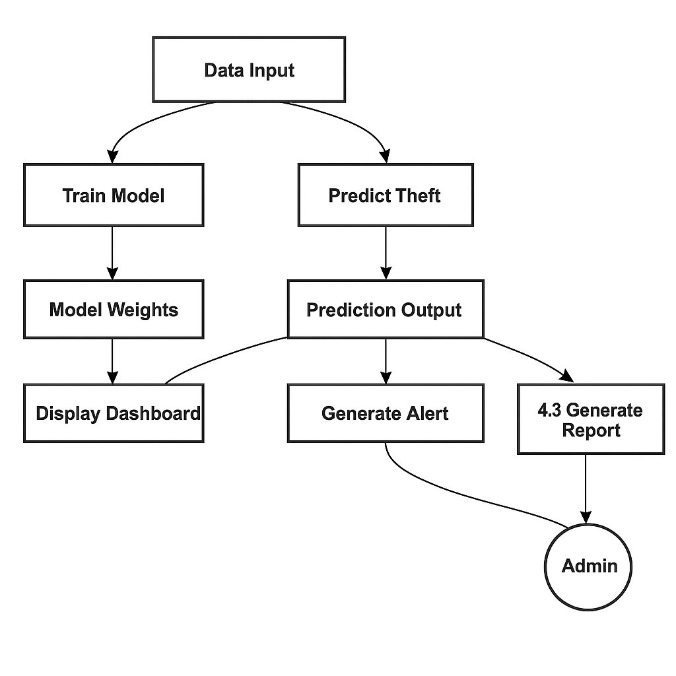
DFD DIAGRAM

Slide 19
SYSTEM IMPLEMENTATION
Developed using Python in the VS Code environment with integrated Flask
framework for web-based deployment.
Allows administrators to upload and analyze electricity consumption datasets (CSV
format) for theft detection.
Implements data preprocessing: handling missing values, normalization using
MinMaxScaler, and balancing using SMOTE.
Utilizes five machine learning models:
◆ XGBoost – selected as the best model based on accuracy and recall
◆ Random Forest, Decision Tree, SVM, and ANN – for comparative evaluation
Includes admin login authentication and secure role-based access to ensure
restricted model use.
Predictions are displayed with intuitive alerts and theft risk indicators through a
web interface.
Designed with a modular structure for scalability, allowing easy integration of
future theft detection techniques.

Slide 20
RESULTS / PERFORMANCE EVALUATION
Model | Accuracy | Recall | Precision | F1-Score | Training Time
XGBoost | 83.08% | 0.87 | 0.77 | 0.82 | Low
Random Forest | 84.67% | 0.85 | 0.75 | 0.81 | Medium
Decision Tree | 75.15% | 0.72 | 0.70 | 0.70 | Very Low
SVM | 62.25% | 0.60 | 0.57 | 0.59 | High
ANN | 53.37% | 0.52 | 0.50 | 0.50 | High

Slide 21
CONCLUSION
The proposed system effectively detects electricity theft using advanced machine learning models, with XGBoost delivering the highest accuracy and recall.
Data imbalance, a major challenge in theft detection, was successfully handled using SMOTE, improving the system’s ability to detect minority theft cases.
Preprocessing, feature selection, and model evaluation pipelines were carefully designed to ensure robustness, scalability, and high classification performance.
The Flask-based dashboard provides a real-time, user-friendly interface for administrators to monitor usage patterns and receive theft alerts.
Overall, the system demonstrates high accuracy, fast execution, and practical deployment capability for improving the resilience of modern smart grids.

Slide 22
SCOPE FOR FUTURE ENHANCEMENT
Real-Time Smart Meter Streaming Support:
The system can be extended to handle live streaming data from IoT-based smart meters, allowing real-time detection and alerting of fraudulent activities.
Geospatial and Customer Behavior Analysis:
Incorporating customer location data and historical behavioral patterns may improve detection accuracy and help identify regional theft trends.
Blockchain Integration for Data Security:
Blockchain can be used to securely log and validate electricity usage data, ensuring tamper-proof records and enhancing the transparency of the detection process.
Mobile-Based Admin Interface:
Developing a mobile-friendly dashboard or app can enable field operators and utility administrators to access theft alerts and reports on-the-go.

Slide 23
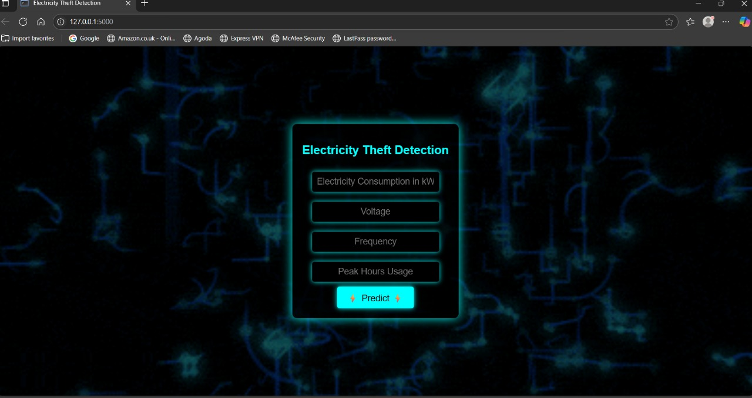
SCREENSHOTS OF IMPLEMENTATION

Slide 24
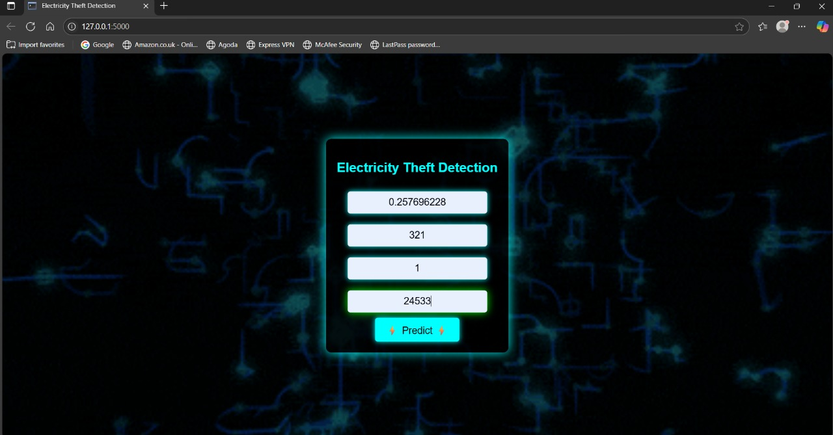
SCREENSHOTS OF IMPLEMENTATION

Slide 25
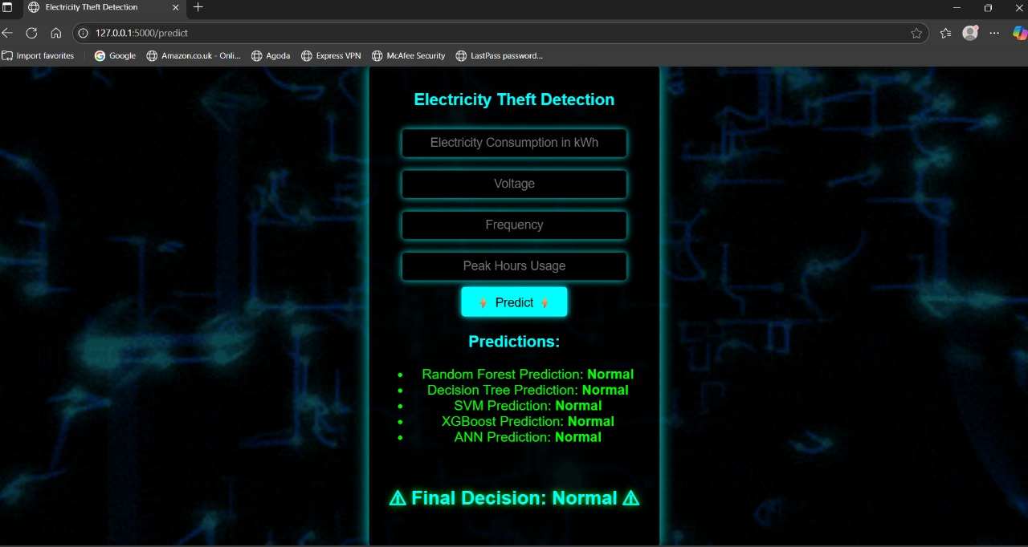
SCREENSHOTS OF IMPLEMENTATION

Slide 26
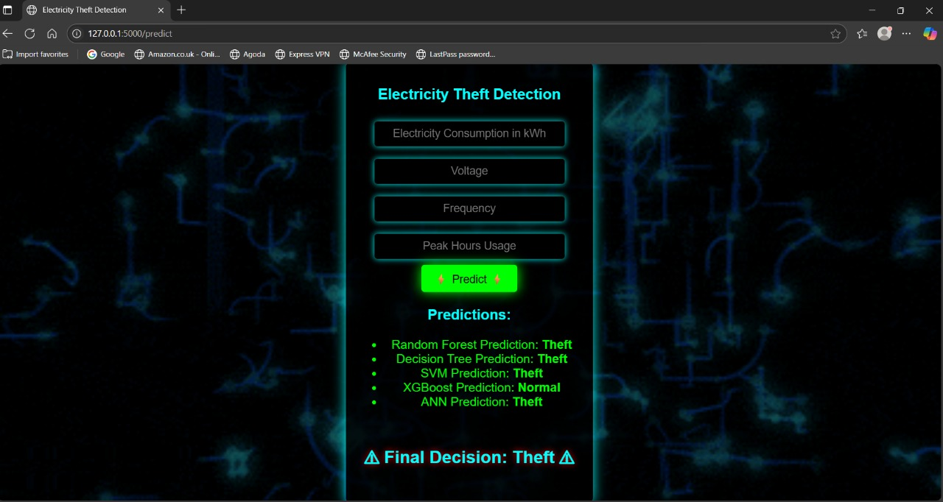
SCREENSHOTS OF IMPLEMENTATION

Slide 27
SAMPLE CODE
ml_model_training.py import pandas as pd
import numpy as np
import joblib
from sklearn.model_selection import train_test_split
from sklearn.preprocessing import StandardScaler
from sklearn.metrics import accuracy_score, classification_report
from sklearn.tree import DecisionTreeClassifier
from sklearn.ensemble import RandomForestClassifier
from sklearn.svm import SVC
import xgboost as xgb
from tensorflow import keras

Slide 28
REFERENCES
1. A Comprehensive Review on Electricity Theft Detection using ML Techniques – IJERT, 2023.
2. Smart Meter Based Frameworks for Theft Detection – Elsevier Energy Reports, 2022.
3. Comparative Study on ML Classifiers for Power Theft – IEEE Access, 2022.
4. Anomaly Detection Using XGBoost for Power Consumption – Springer, 2021.
5. Real-time Electricity Theft Monitoring via Smart Grids – IEEE IoT Journal, 2023.

Slide 29

THANK YOU

